Slide 1

First Communion songs

Slide 2
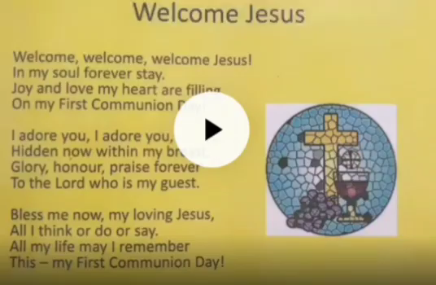

Entrance :
Welcome Jesus
Welcome, welcome, welcome Jesus!
In my soul forever stay.
Joy and love my heart are filling
On my First Communion Day!
I adore you, I adore you,
Hidden now within my breast.
Glory, honour, praise forever
To the Lord who is my guest.
Bless me now, my loving Jesus,
All I think or do or say.
All my life may I remember
This – my First Communion Day!

Slide 3


Psalm:
Gift to you
Everything I am ,
Everything I'll be,
I give it to you lord
And do it thankfully ,
Thankfully
Every song I sing
every praise I bring
Every thing I do its a gift to you .
Everything I have
All you’ve given me
I give it to you lord and do it thankfully. Every song I sing, every praise I bring, everything I do, is a gift to you.

Slide 4

Gospel Acclamation
Alleluia, Alleluia,
Alleluia, Alleluia, Alleluia, Alleluia. (repeat)
Open our hearts, O Lord
To accept the words of your Son.
Alleluia, Alleluia, Alleluia,
Alleluia, Alleluia, Alleluia.

Slide 5
Offertory
The Last supper.
1. Jesus took the bread he broke.
Jesus shared the bread he broke,
And said, ‘Do this, do this in memory of me.’
Jesus took the bread he broke.
Jesus shared the bread he broke and said,
‘Do this, do this in memory of me’.
2. Jesus took the wine he poured.
Jesus shared the wine he poured,
And said, ‘Do this, do this in memory of me.’
Jesus took the wine he poured.
Jesus shared the wine he poured,
And said, ‘Do this, do this in memory of me’

Slide 6
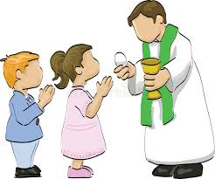
Communion songs:
It's me oh lord
Its me, it's me, O Lord,
Standin' in the need of prayer;
It's me, it's me, O Lord,
Standin' in the need of prayer.
Not my brother not my sister,
Not my father not my mother
Not the stranger not my neighbour

Slide 7
Communion songs:
Eat this bread.
Eat this bread
Drink this cup,
come to me and never be hungry
Eat this bread
Drink this cup
Trust in me and you will not thirst.

Slide 8
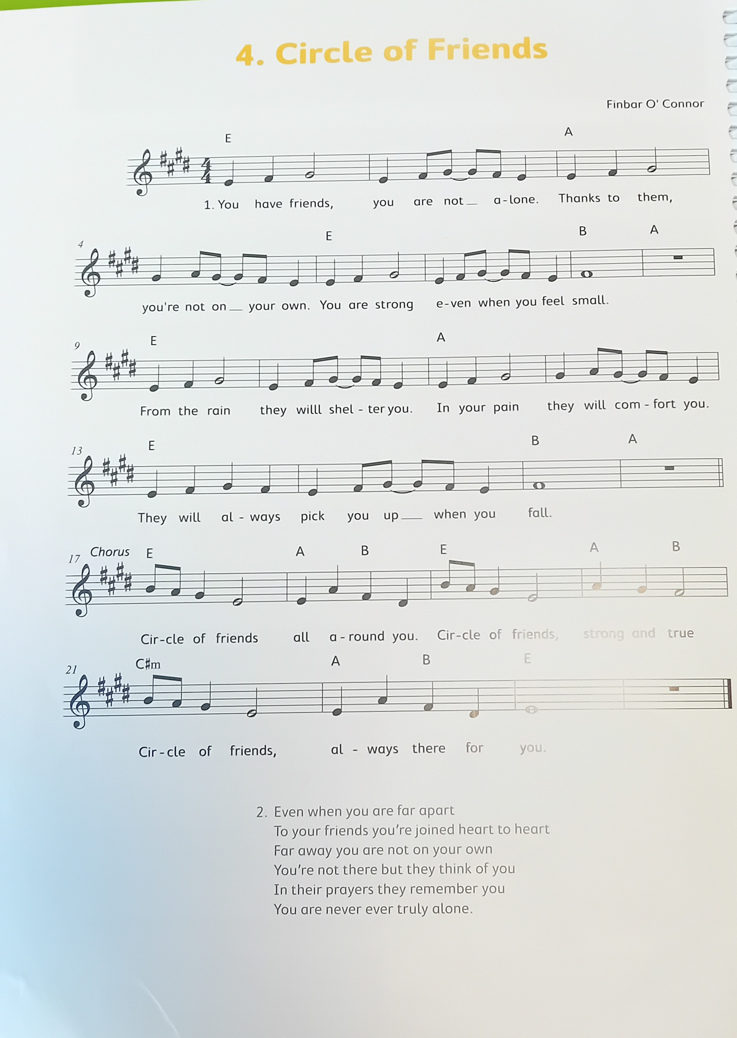

Circle of Friends

